Slide 1
LECTURE -3c
Descriptive Statistics Part (c)
Course Intructor
Engr. Naina Said

Slide 2
Measures of Relationship between Variables

Slide 3
Covariance
CSE-422: Data Analytics
Often in a dataset, there is a relationship between different variables/features.
We care about finding this relationship because it helps us with taking good
decision.
It also helps in “Feature Selection” part of machine learning pipeline.
Covariance can be one of the three types
Positive covariance.
Negative covariance.
No covariance.
Covariance help us quantify this relationship.

Slide 4


Positive Covariance
CSE-422: Data Analytics
One variable increases as the second variable increases.
Ice cream sales increase as the temperature increase

Slide 5

Negative Covariance
CSE-422: Data Analytics
One variable increases as the second variable decreases.
Number of flu patients in a hospital increase as the temperaturedecreases.

Slide 6


No Covariance
CSE-422: Data Analytics
Increasing or decreasing one variable has no effect on the second variable.
No relationship between your grades and the temperature.

Slide 7
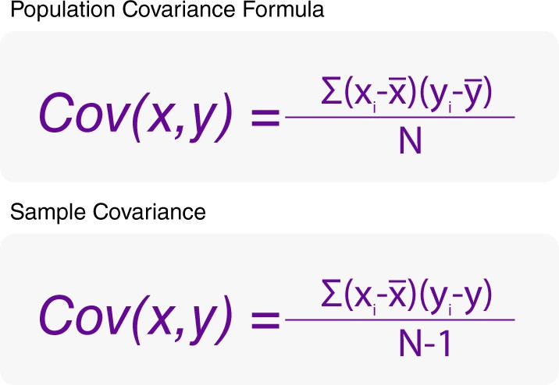
Calculating Covariance
CSE-422: Data Analytics

Slide 8
Covariance Example
CSE-422: Data Analytics
S # | X | Y | X-x̅ | Y-𝒀 | (X-𝑿)(Y-𝒀)
1 | 30 | 5 | -3 | -1 | 3
2 | 35 | 8 | +2 | +2 | 4
3 | 40 | 8 | +7 | +2 | 14
4 | 25 | 4 | -8 | -2 | 16
5 | 35 | 5 | +2 | -1 | -2
Mean | 33 | 6 |  |  | Sum=35
Cov(x,y)= 35/4=8.75

Slide 9
Covariance Value Interpretation
CSE-422: Data Analytics
The value of covariance could be
Positive = which means the two variables are positively related
Negative = which means the two variables are negatively related.
Zero = which means the two variables are not related.

Slide 10
Shortcomings of Covariance
CSE-422: Data Analytics
Covariance only tells about the Direction of relationship but does not tell about the “Strength of Relationship”.
If two variables have a positive relation, how positive it is?
If two variables have a negative relation, how negative it is?
To tackle this, we use Correlation Coefficient.

Slide 11

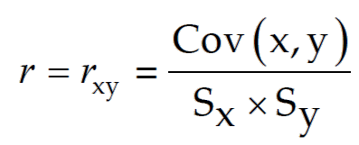
Pearson Correlation Coefficient
CSE-311: Technical Writing
Also known as simple correlation coefficient.
Measures the nature and strength between two variables of the quantitative
type.
The sign of r denotes the nature of association.
The value of r denotes the strength of association.

Slide 12
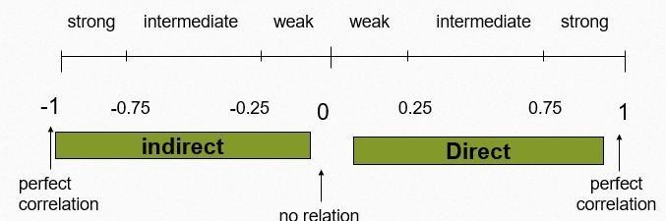
Pearson Correlation Coefficient Continued..
CSE-422: Data Analytics
The value of r ranges between ( -1) and ( +1)
The value of r denotes the strength of the association as illustrated bythe
following diagram

Slide 13
Interpreting “r”
CSE-422: Data Analytics
For direct relationship,
If r = Zero this means no association or correlation between the two variables.
If 0 < r < 0.25 = weak correlation.
If 0.25 ≤ r < 0.75 = intermediate correlation /moderatelystrong.
If 0.75 ≤ r < 1 = strong correlation.
If r = l = perfect correlation.

Slide 14
Example 1
CSE-422: Data Analytics
A sample of 6 children was selected, data about their age in years and weight in kilograms was recorded as shown in the following table . It is required to find the correlation between age and weight.
serial No | Age (years) | Weight (Kg)
1 | 7 | 12
2 | 6 | 8
3 | 8 | 12
4 | 5 | 10
5 | 6 | 11
6 | 9 | 13

Slide 15
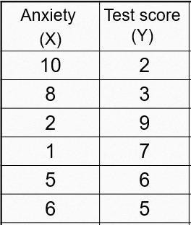
Example 2
CSE-422: Data Analytics
Find the correlation between anxiety and test scores of students as given in the table below.

Slide 16
Scatter Plots for Visualizing Correlation
CSE-422: Data Analytics
Scatter Plot is a graphical representation of two quantitative variables inwhich the explanatory variable is on the x-axis and the response variable is on the y- axis.
Helps us with
Direction (positive or negative)
Strength (weak, moderate, strong)
Bivariate outliers

Slide 17
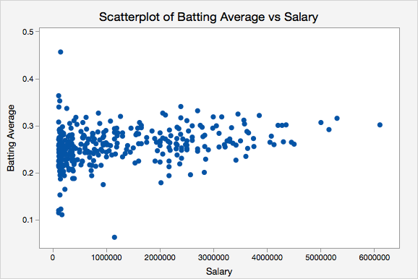
Example 1
CSE-422: Data Analytics
Verdict : No relationship

Slide 18
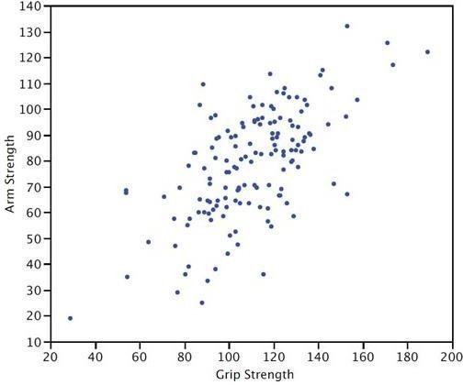
Example 2
CSE-422: Data Analytics
Relationship : Direct / Positive Strength : Intermediate

Slide 19
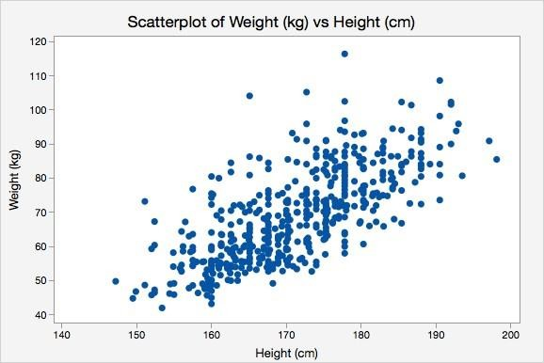
Example 3
CSE-422: Data Analytics
Relationship : Direct/Positive Strength : Intermediate

Slide 20
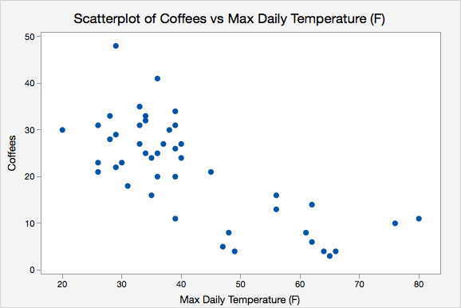
Example 4
CSE-422: Data Analytics
Relationship : Negative/Positive Strength : Moderately Strong

Slide 21
Assignment
CSE-422: Data Analytics
"Correlation Is Not Causation” What does it mean???
Hint : Watch this TedTalk to know
The danger of mixing up causality and correlation: Ionica Smeets at TEDxDelft
Find some funny misleading correlations on the internet and report in your assignment.

Slide 22

Standard Error of Sample Mean
CSE-422: Data Analytics
Sample mean is actually the estimate of population mean.
But how confident can we be that the sample mean is the true estimate of the
population mean.
Larger the sample size, more confident we will be.
Smaller the sample size, less confident we will be.
This measure of uncertainty in the sample mean is called “Standard Error of
Sample Mean”.

